Slide 1
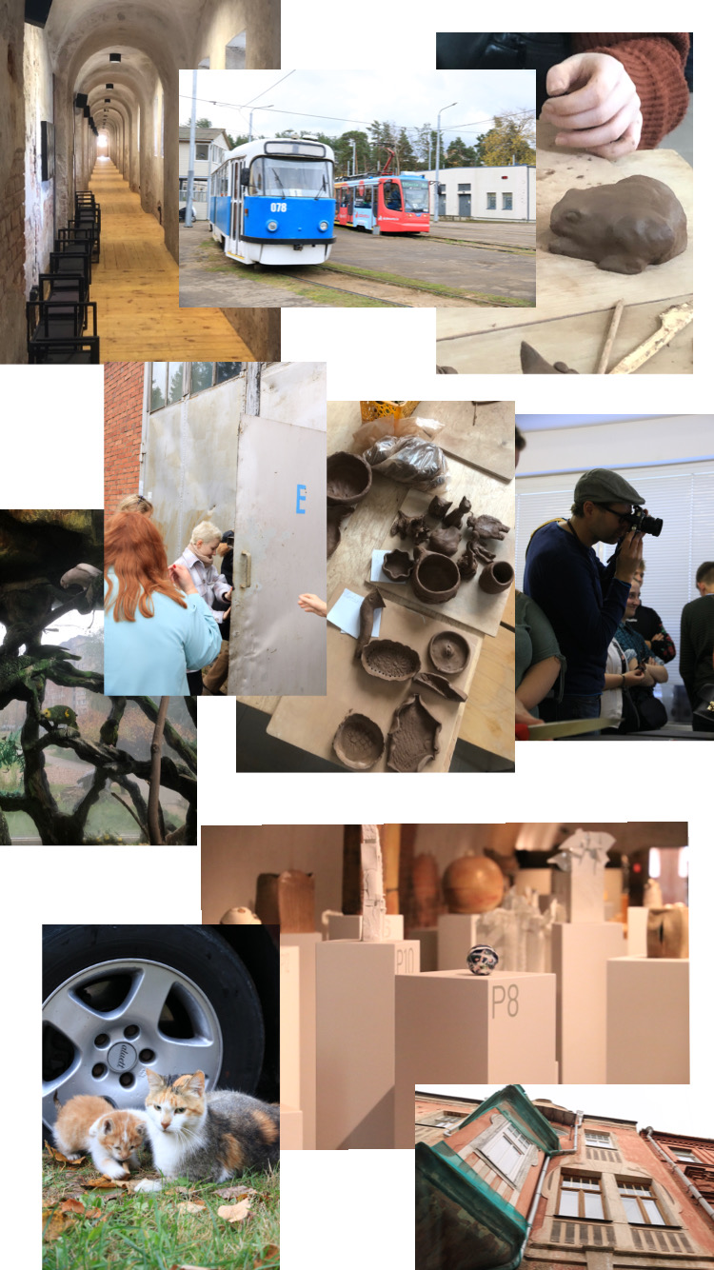
Ecology Event In Latvia
.

Slide 2
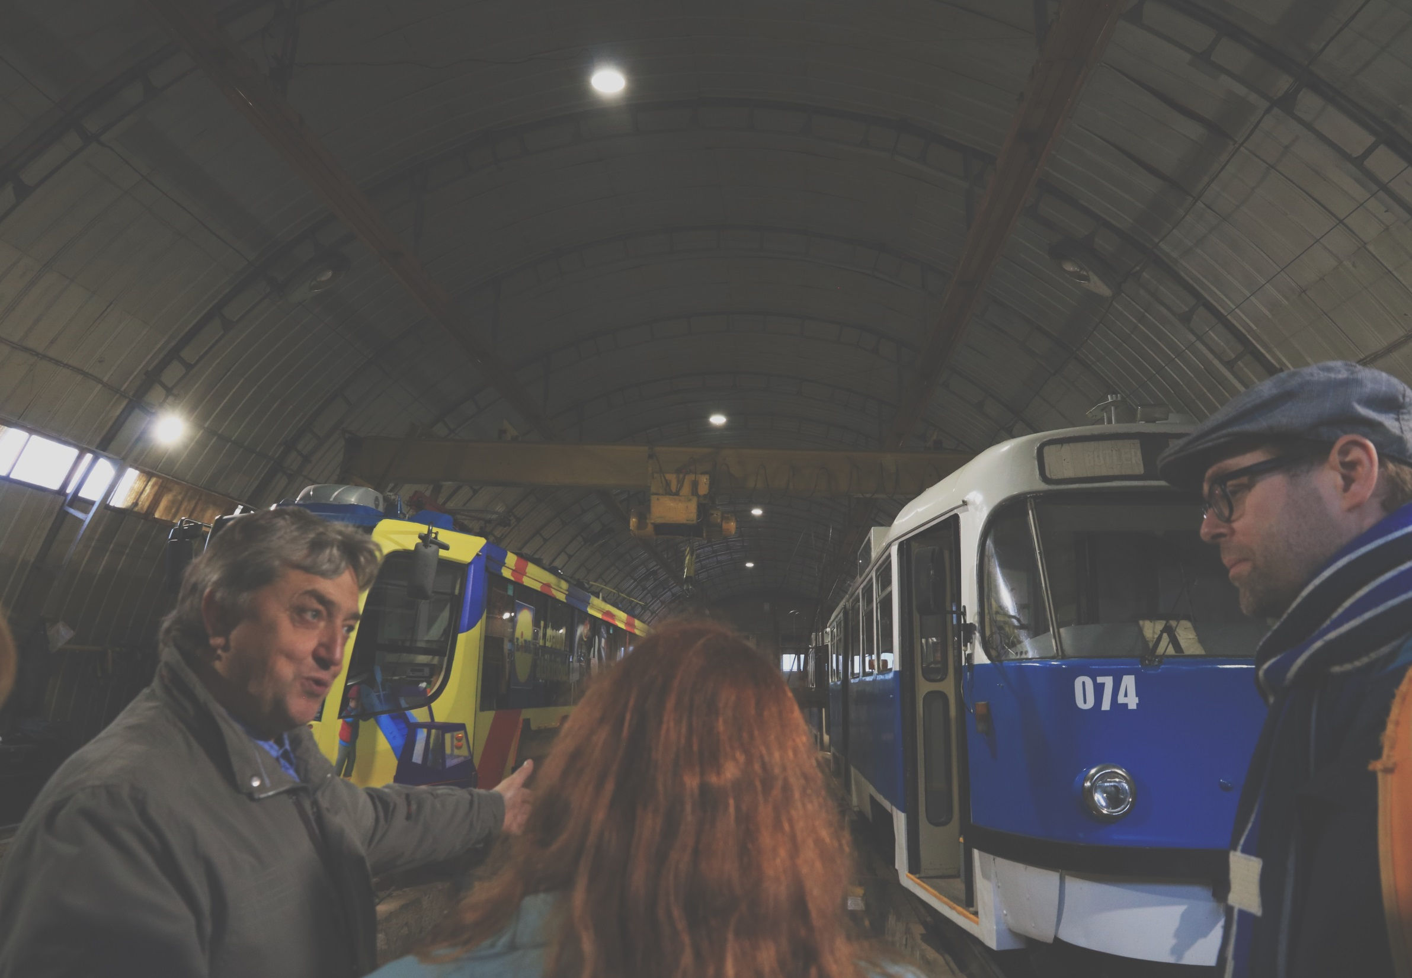
Natural friendly vehicles
On Tuesday they introduced us the local transport, some trams that were working by eletricity. Also some busses tha worked by gas
Trams, trains and subways are known for being environment friendly, because they don’t use any toxic chemicals like fossil fuels.

Slide 3
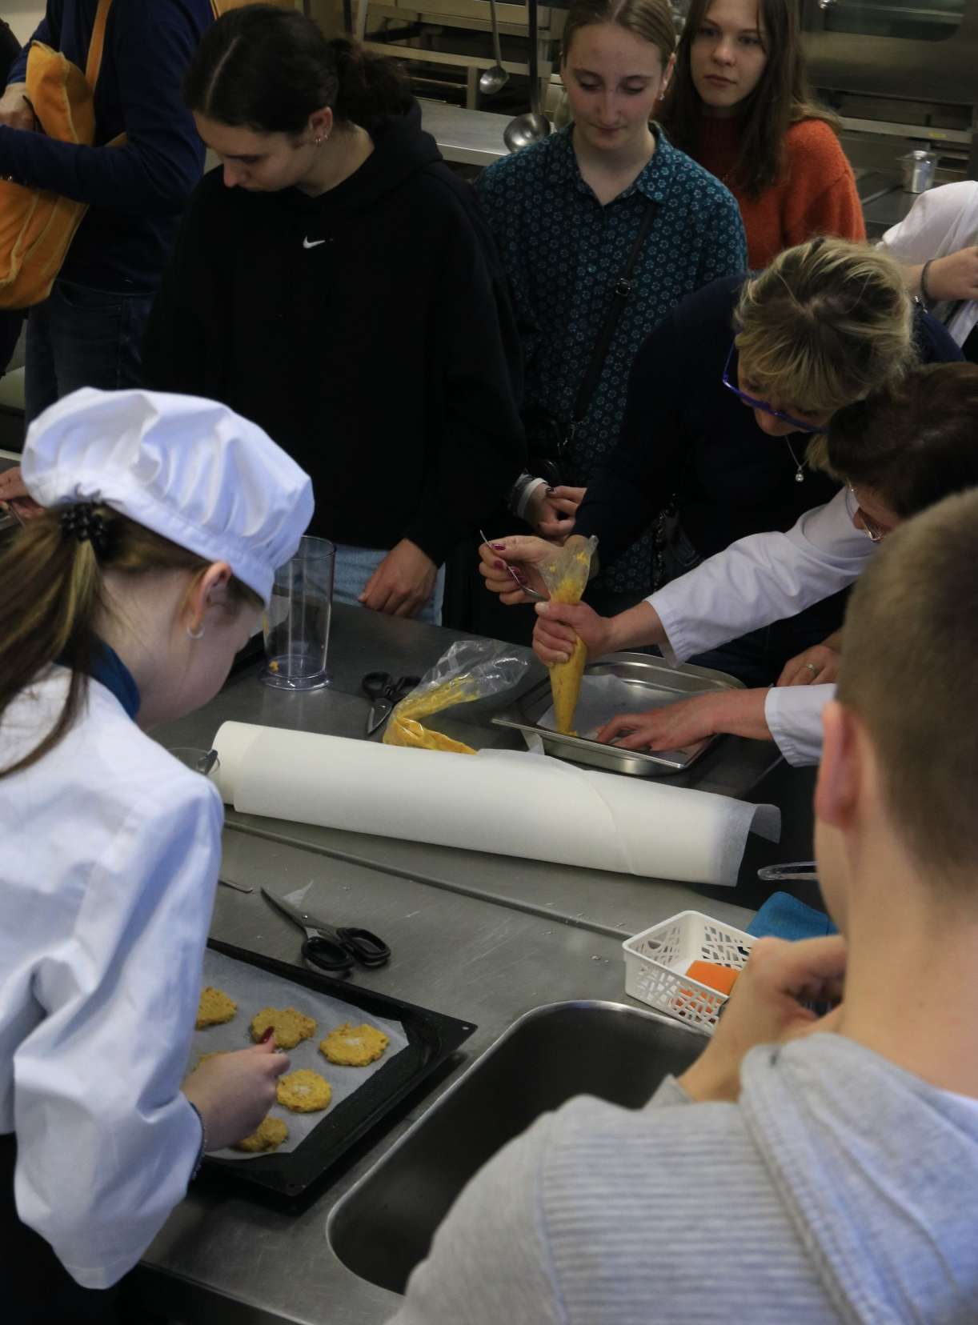
Our experience of zero waste cooking
On the Monday afternoon we made cookies and pumpkin soup.
Pumpkin is seasonal vegetable so it’s good choice for nature. Also that event had zero waste theme, all the food was eaten.

Slide 4

Facts we learned about saving nature
We didn’t know that there are so many ways of saving nature, for example water purification. They told that the water is purified so it’s not pouring back to river so it doesn’t pollute
Also the every day choices we make, effect nature a lot. For example food, clothes, transport and living.

