Slide 1
Experience in Latvia
Ula, Sofija, Katja, Heli

Slide 2
Things we liked:
Tasty chocolate
Zoo
Art centre
Pottery making

Slide 3
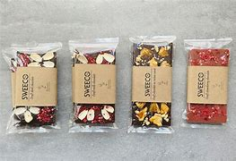
Tasty chocolate

Slide 4
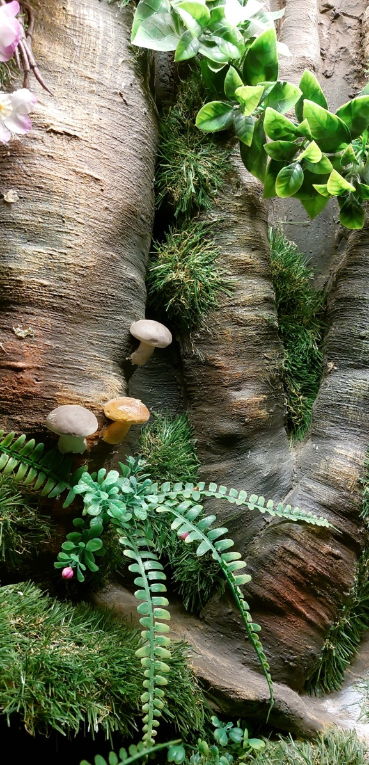
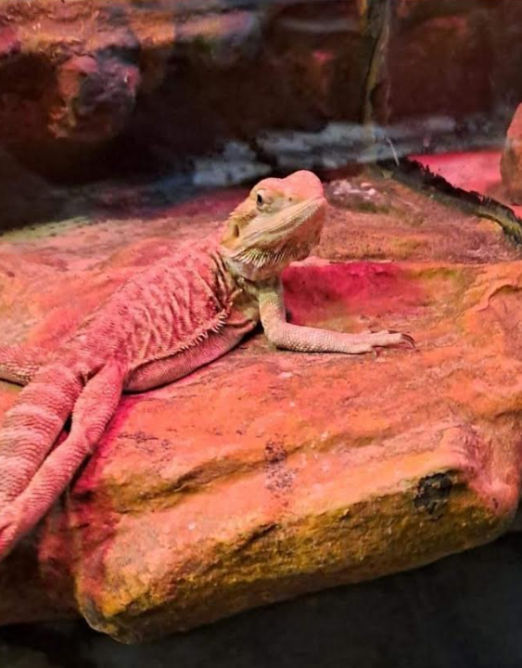
Zoo

Slide 5
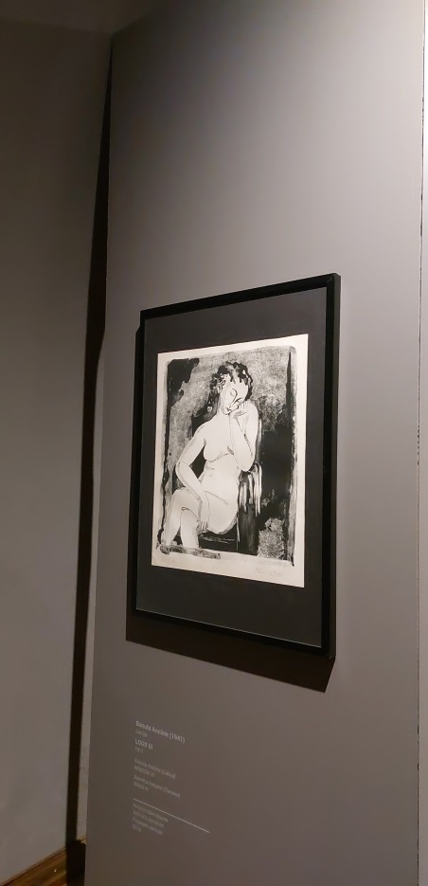
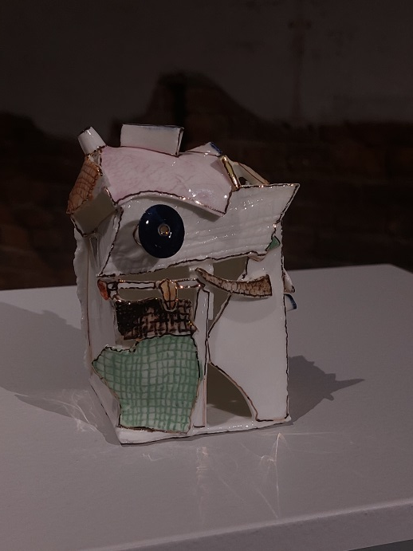
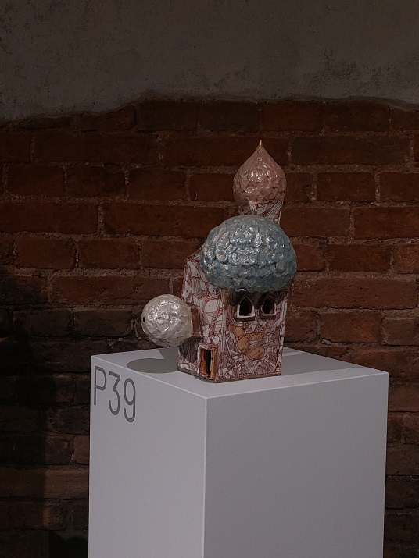
Art centre
/

Slide 6
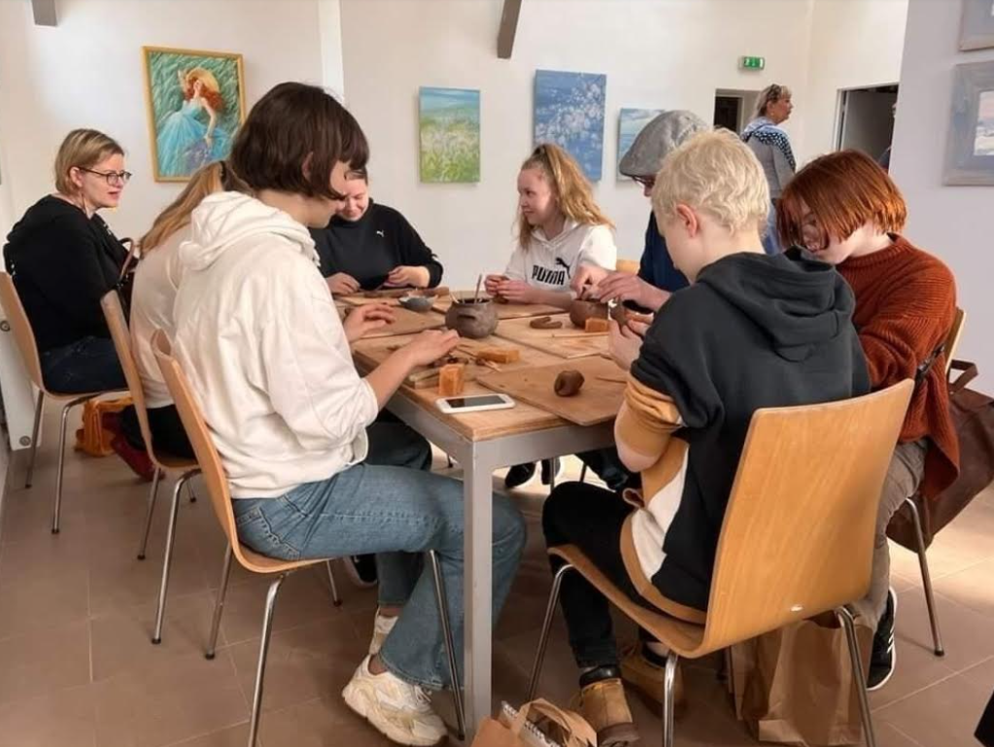
Pottery making
/

