Slide 1
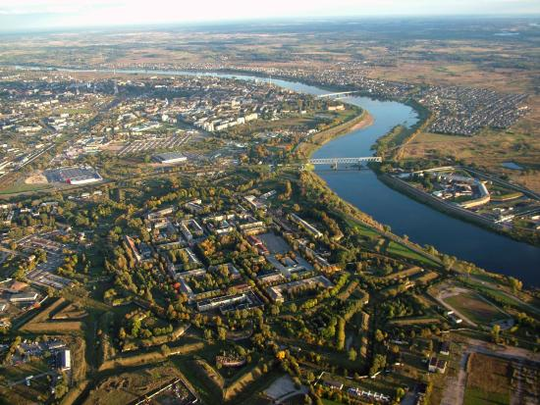
Most memorable places

Slide 2
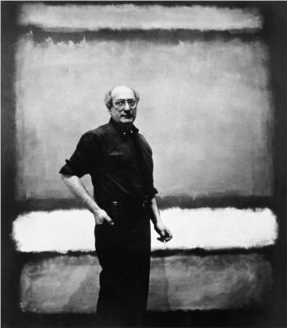
Museum
On Wednesday we went to the museum and learned about Marko Rothko.
We learned about Marko’s painting style and Martinsons House.
The fortress has become the basis of the city and a popular tourist attraction.

Slide 3
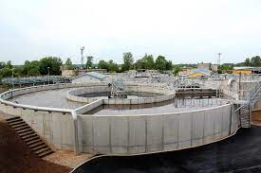
Water purification plants
On Thursday we visited the water purification plants.
We learned that the water is purified with bacteria.
The water is mined from deep underground
People called “hydrogeologist” search for water
Water purification is important because dirty water can cause biofilm in damp spaces

Slide 4
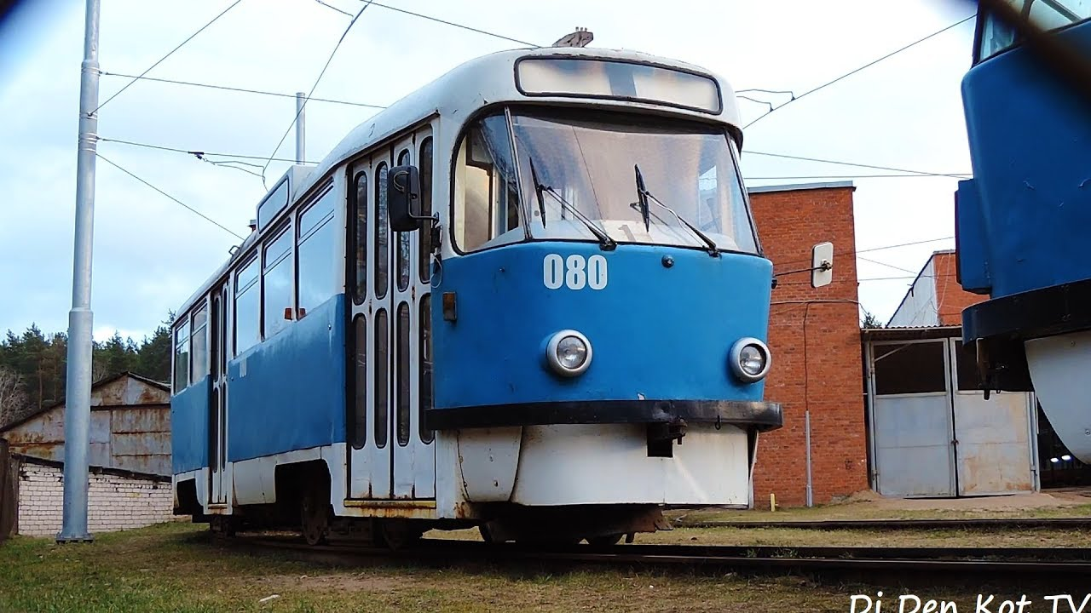
Trams
On Tuesday we visited the Muncipal public transport company and learned about eco-friendly public transport.
The trams use electricity and don’t clog the enviornment.
Trams offer a modern and convienient way of transport.

