Slide 1
Our emotions about this week
Ula, Silja, Nikita, Aino, Edgar.

Slide 2
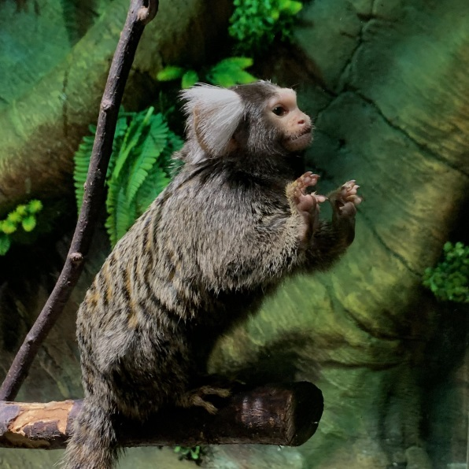
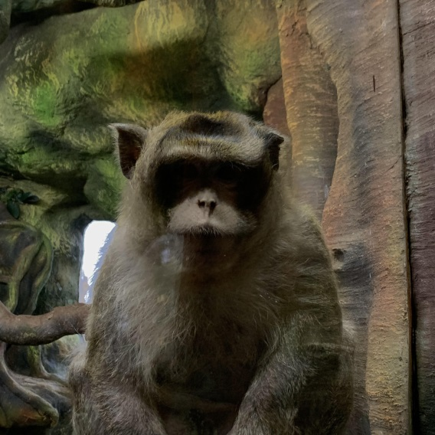
Zoo
The zoo was too small but animals were beautiful, funny and exotic. Animals don’t have much space. By our opinion is a big problem because animals can be afraid and they can’t hide from people.
In conclusion we can say that the zoo needs more space, but otherwise everything was fine.

Slide 3
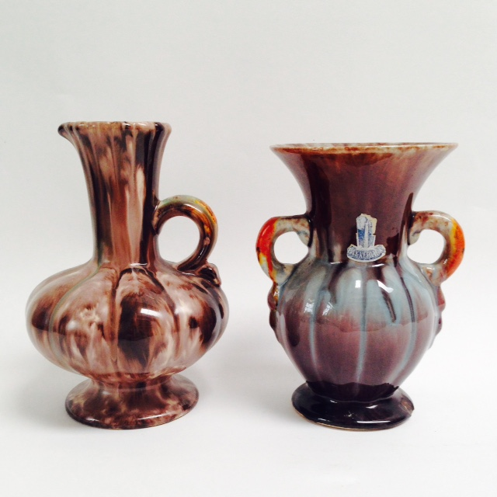
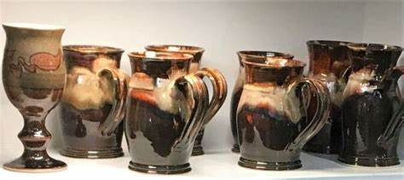
Pottery
It was interesting to know how to make pots, it was relaxing and you show imagination when you make a pot.
And we liked it ☺
We also liked the pots that were made by the studens and then representative and his sons.

Slide 4
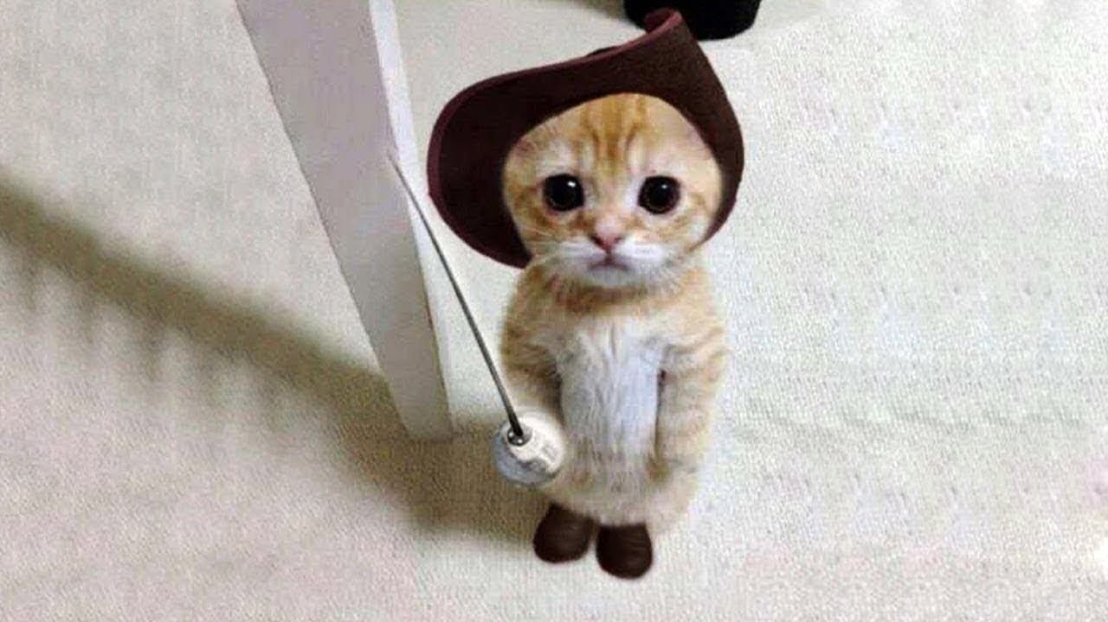
THANKS FOR YOUR ATTENTION :D

