Slide 1
TRIP TO LATVIA
NordPlus2022

Slide 2
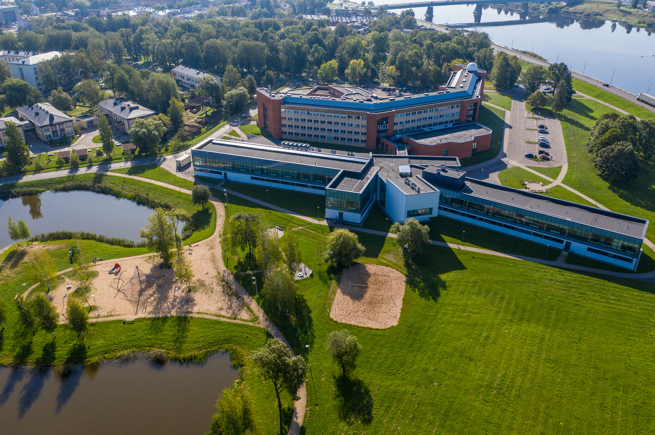
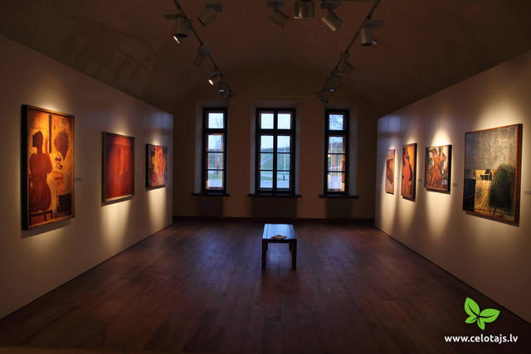
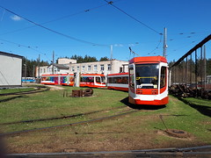

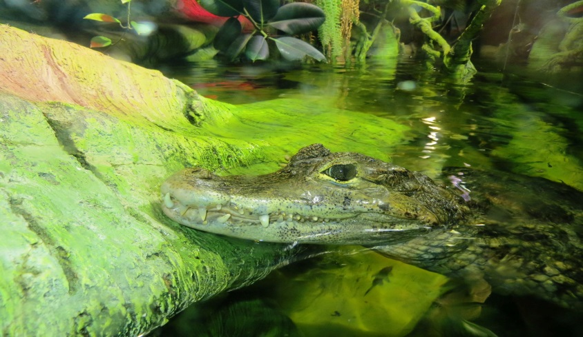
things that we liked about this week
Mark Rothko art centre
Tram depo
The zoo
The university

Slide 3
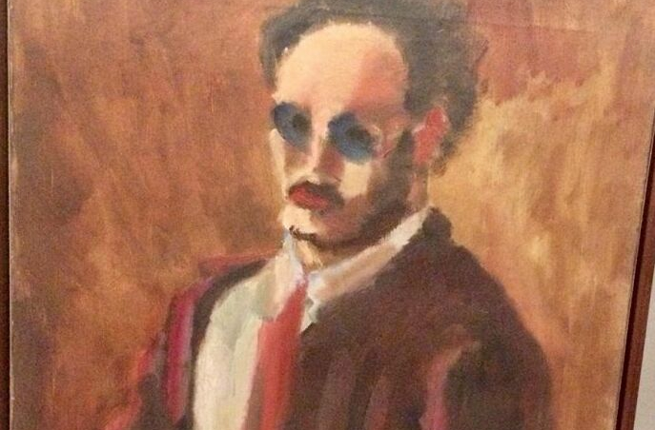
Marko Rothkos Art Centre
In Mark Rothkos art centre we learned more about his life and got to see replicas of his paintings

Slide 4

Tram depo
In the tram depo we learned about the history of trams, how they affect the environment etc

Slide 5
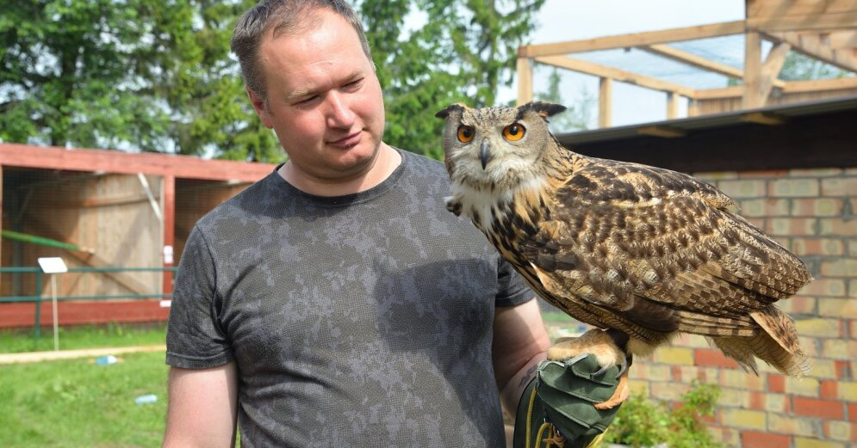
Zoo
At the zoo we saw all kinds of animals, from rabbits to crocodiles

Slide 6
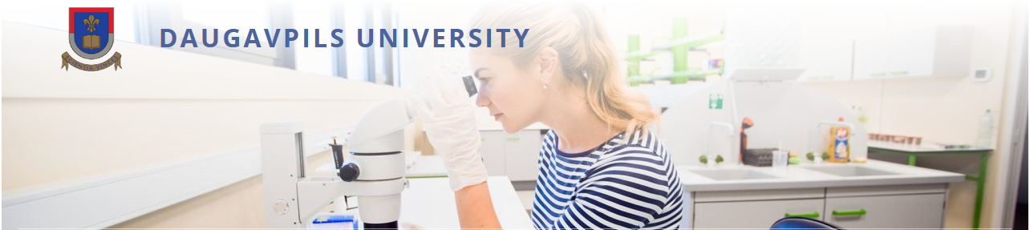
University
In the university we saw a lot of things, learned about science and what they do there, we learned about cloning etc

Slide 7
We learned about recycling, reusing etc
We had a virtual tour of the ‘Getlini EKO’ landfill

Slide 8
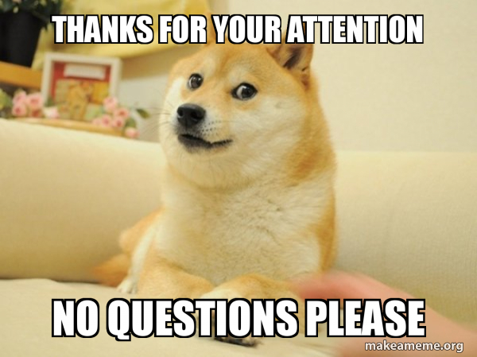
Thanks for your attention

