Slide 1
Eco trip to latvia

Slide 2

Daugavpils eco friendliness
This week we’ve been learning about ecology in Daugavpils and been visiting a variety of different places that are eco friendly. We chose two of the most interesting ones in our opinion that help environment dramatically.

Slide 3
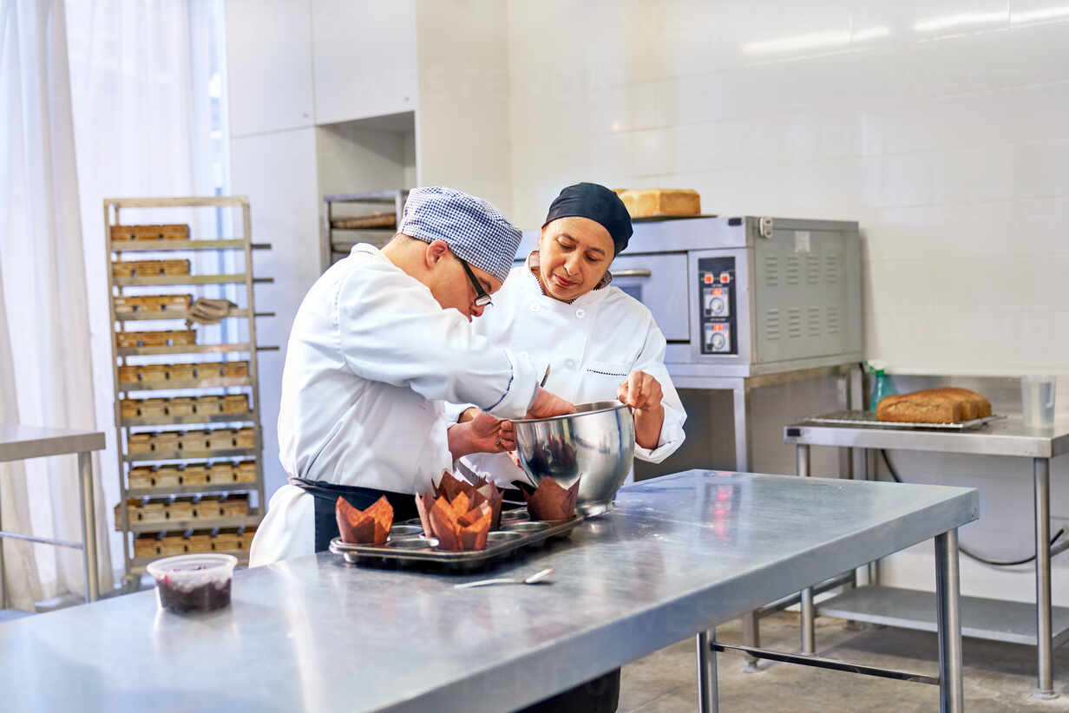
zero-waste cooking class
On Monday we visited a zero-waste cooking class where we learned how to use the waste that you would have after completing your dish. We helped with making pumpkin cookies as well as cut bread for the pumpkin soup.
The main idea is that you
use the remainings of the
product that you’ve
cooked to create
something new. That way
we can help to reduce
waste and help the
environment.

Slide 4
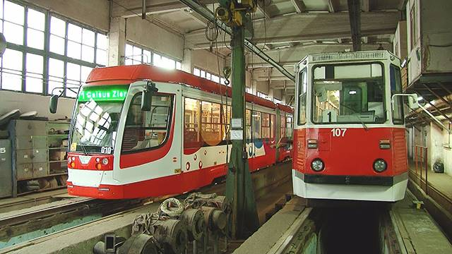
daugavpils satiksme
The next day after we visited the cooking class we went on excursion to see the «Daugavpils Satiksme» where we learned about trams and how they are good for our environment. We saw how they are storaged and taken care of in depos, learned about trams history in Daugavpils. The trams are eco friendly because they don’t use fuel but electricity.

Slide 5
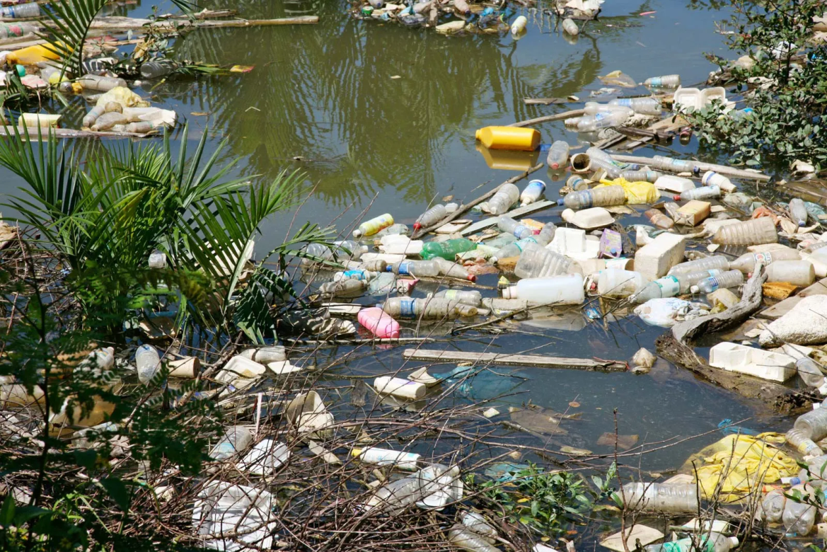
Why eco friendliness?
Nowadays people are all about eco friendly stuff. And it’s a very nice trend since being eco friendly helps to save the planet, preserve nature and our future every day. We believe that it’s a nice thing that more and more companies try to be
ecologically friendly and
reduce the waste that
they produce, especially
since some factories get
rid of their toxic waste by
dumping it into the
water, polluting it.

Slide 6





